Slide 1
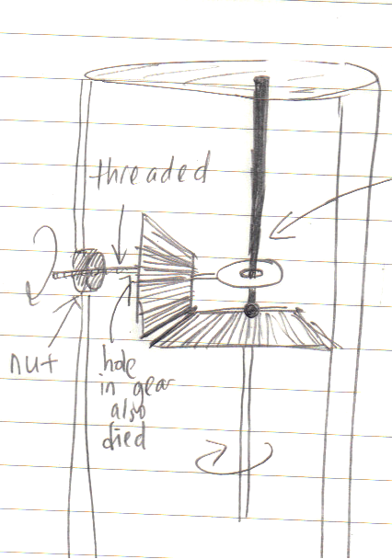
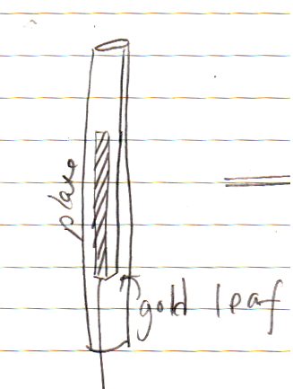
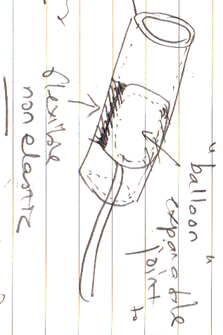
Catheter Guide Wire
Design concepts
Mechanical
Charge
Fluids

Slide 2
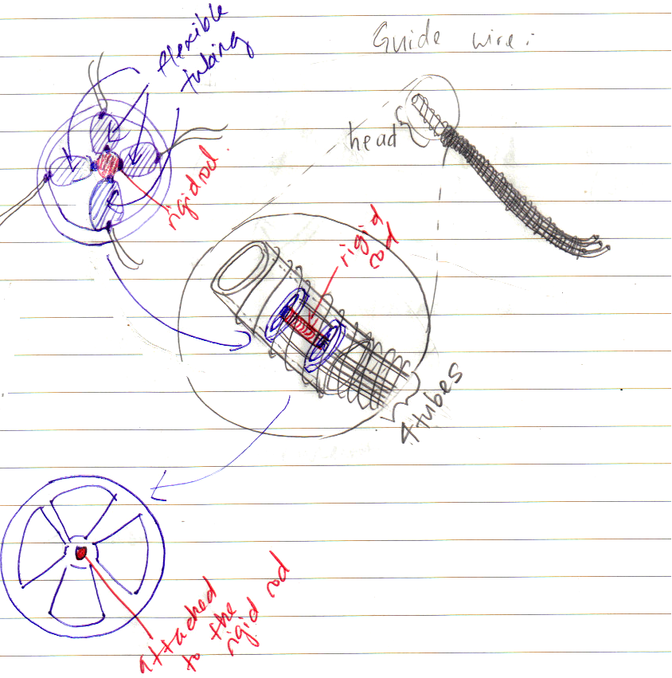
Fluids 1
back

Slide 3
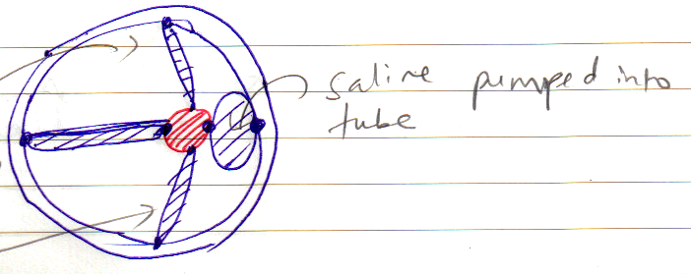
Navigates the direction: fluid is pumped in or out of the tube to displace the rigid rod
Remark
Too complex to manufacture at small scale
back

Slide 4
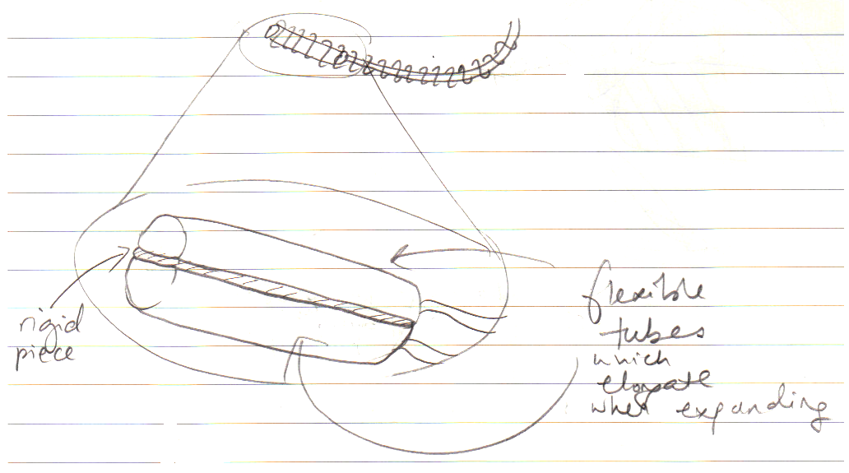
Fluids 2
back

Slide 5
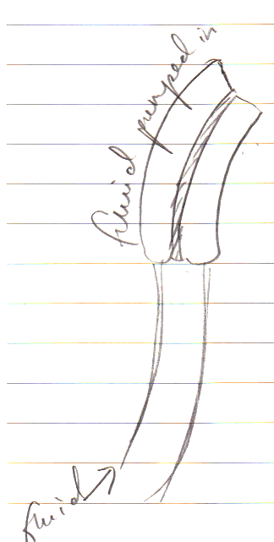
Remark
Requires tubes that expand only lengthwise
back

Slide 6
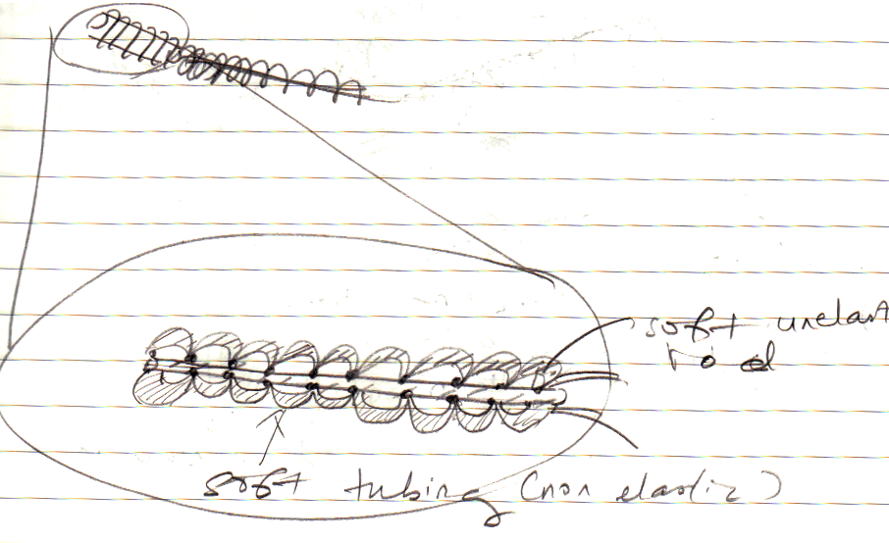
Fluids 2.5
back

Slide 7
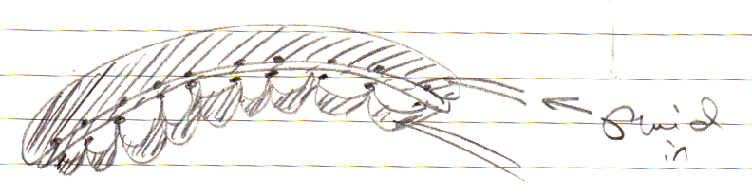
When fluid is pumped into one side:
Remarks:
Adhesion must be accurate and strong
Only bend at one radius of curvature, otherwise the movement is difficult to calculate accurately
back

Slide 8
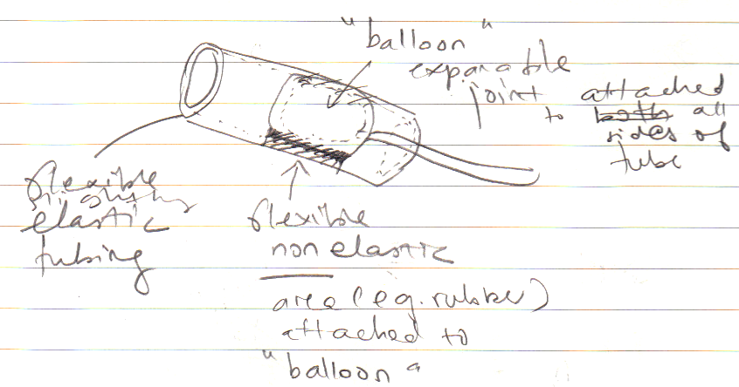
Fluids 3
back

Slide 9
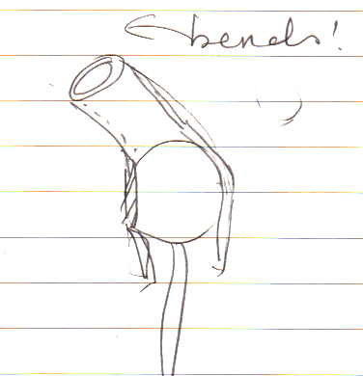
When fluid is added into the “balloon”
balloon expands:
Remark:
Due to manufacturing limitations, the design was slightly modified to Fluids 3.5
back

Slide 10
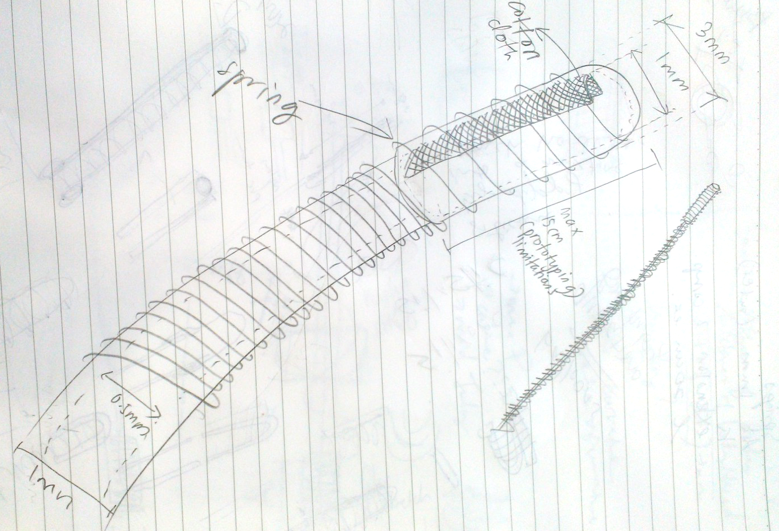
Fluids 3.5
back

Slide 11
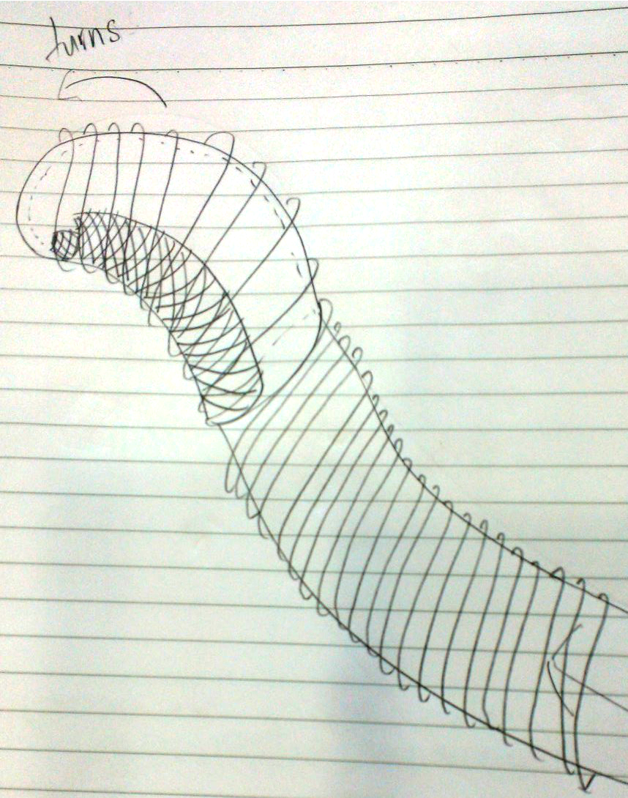
When fluid fills the head:
back

Slide 12
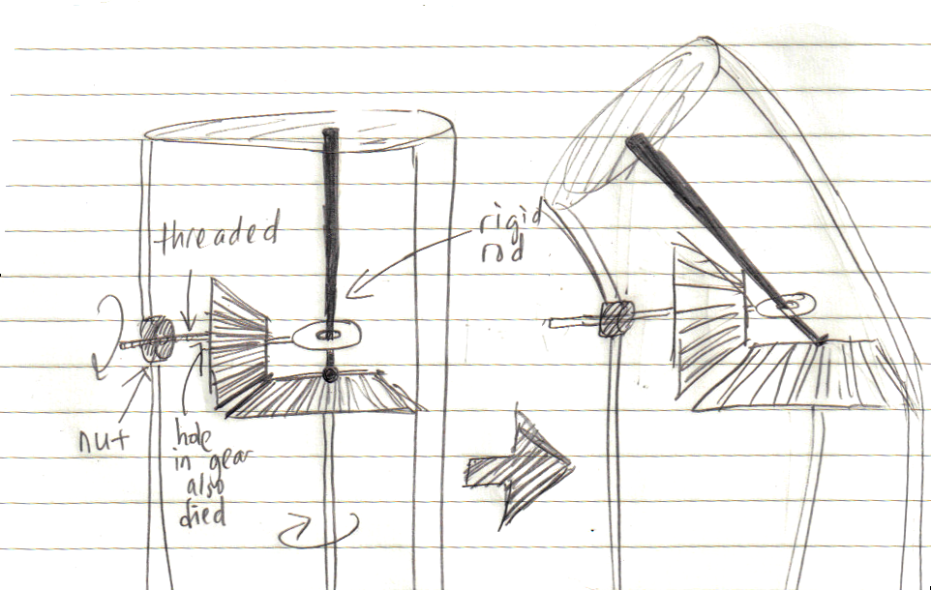
Mechanical
Remark:
Design is too elaborate to manufacture at a small scale
back

Slide 13
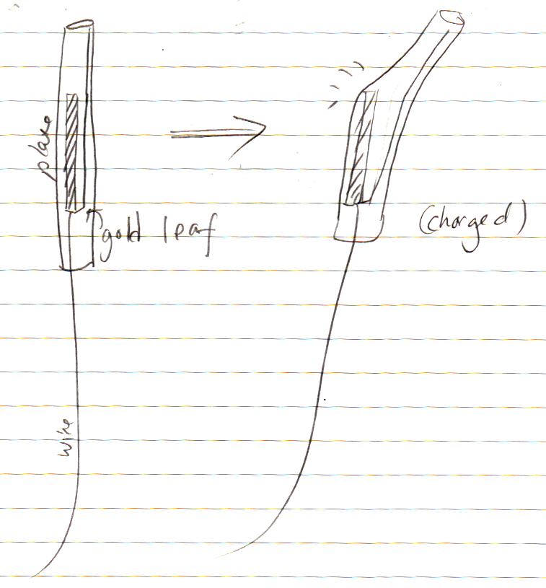
Charge
back

Slide 14
Remarks
Preventing charge leakage is an issue.
This design does not have perfect curvature because of the presence of the plate
back

